Slide 1


Computer Architecture Experiment
Jiang Xiaohong
College of Computer Science & Engineering
Zhejiang University

Slide 2
Topics
0、Basic Knowledge
1、Function Units Design
2、Single-cycle CPU Design
3、Multiple-cycle CPU Design
4、5-stage of pipelined CPU Design
5、 Pipelined CPU with stall
6、Pipelined CPU with forwarding
7、Pipelined CPU resolving control hazard
8、Pipelined CPU support execution 16 MIPS Instructions
9、Course Review

Slide 3
Outline
Experiment Purpose
Experiment Task
Basic Principle
Operating Procedures
Precaution

Slide 4
Experiment Purpose
Understand the principles of Pipelined CPU Bypass Unit
Master the method of Pipelined Pipeline Forwarding Detection and Pipeline Forwards.
Master the Condition In Which Pipeline Forwards.
Master the Condition In Which Bypass Unit doesn’t Work and the Pipeline stalls.
master methods of program verification of Pipelined CPU with forwarding

Slide 5
Experiment Task
Design the Bypass Unit of Datapath of 5-stages Pipelined CPU
Modify the CPU Controller
  Conditions in Which Pipeline Forwards.
  Conditions in Which Pipeline Stalls.
Verify the Pipeline CPU with program and observe the execution of program

Slide 6
Data Hazard Stalls
Minimizing Data Hazard Stalls by Forwarding： In most cases, the problem can be resolved by forwarding, also called bypassing, short-circuiting.
Data Hazards Requiring Stalls: In some cases, data hazards can not be handled by bypassing.

Slide 7
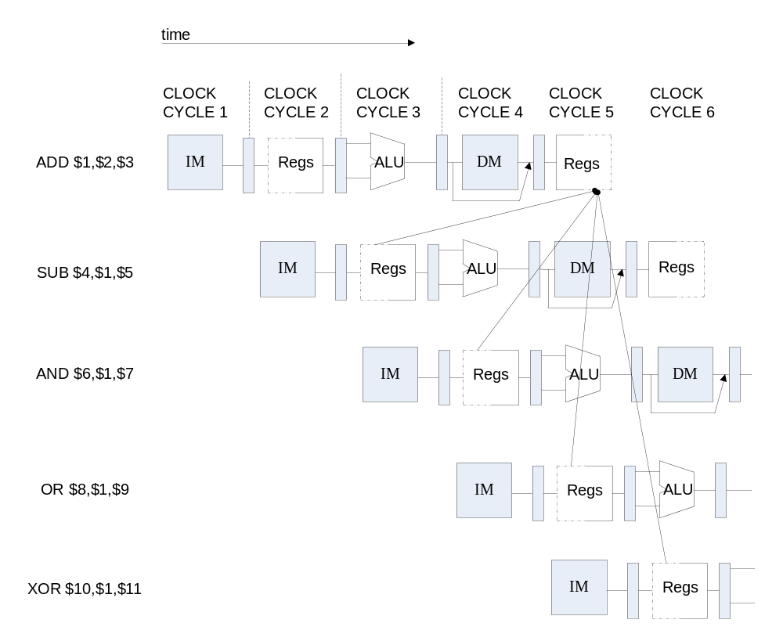
Instruction Demo

Slide 8
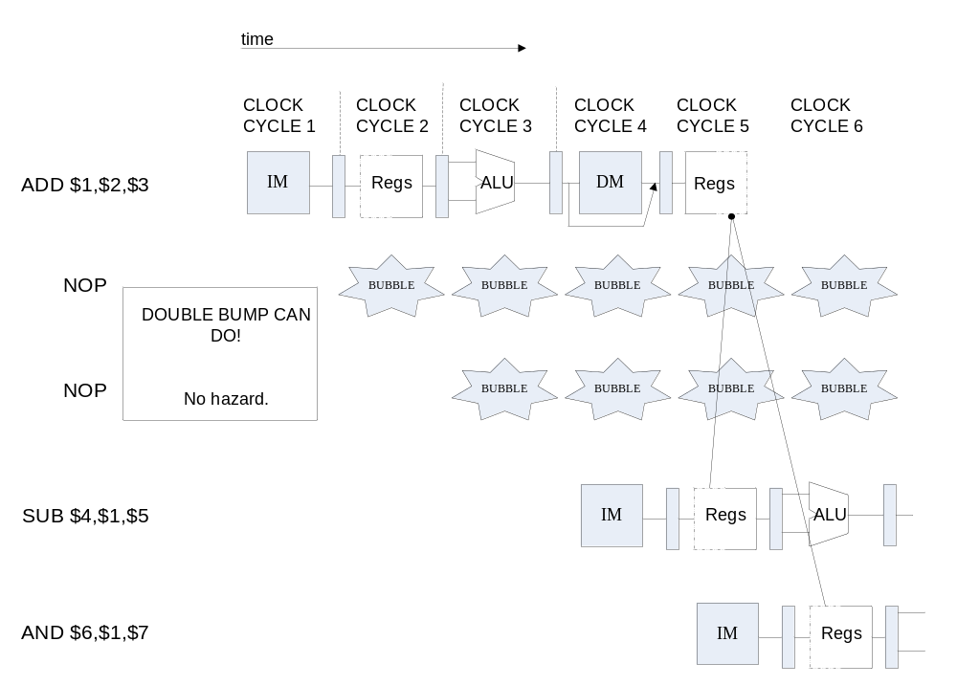
Data Hazard Causes Stalls

Slide 9

Pipeline Forward to Avoid the Data hazard

Slide 10
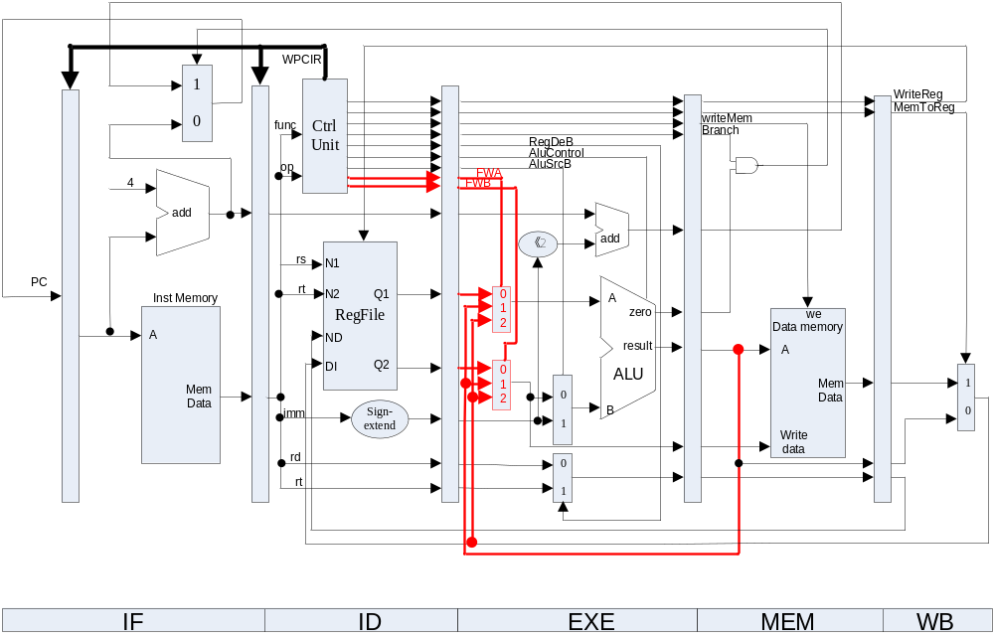
Datapath with Bypass Unit

Slide 11
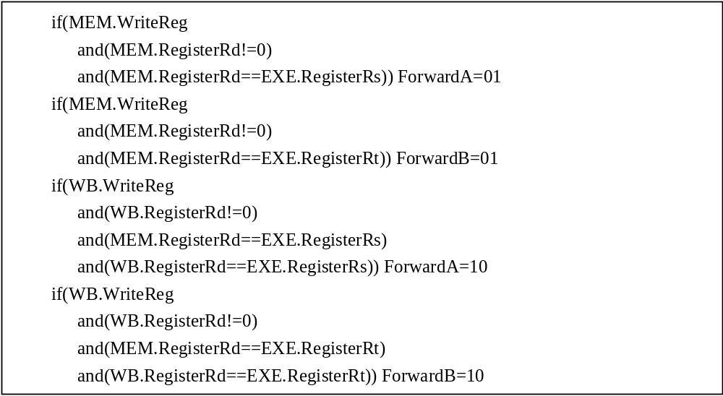
In Which Conditions the Pipeline Forward

Slide 12
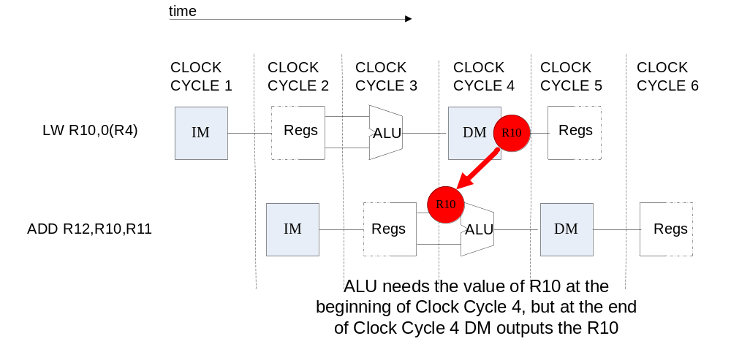
Condition in Which Bypass Unit doesn’t work

Slide 13
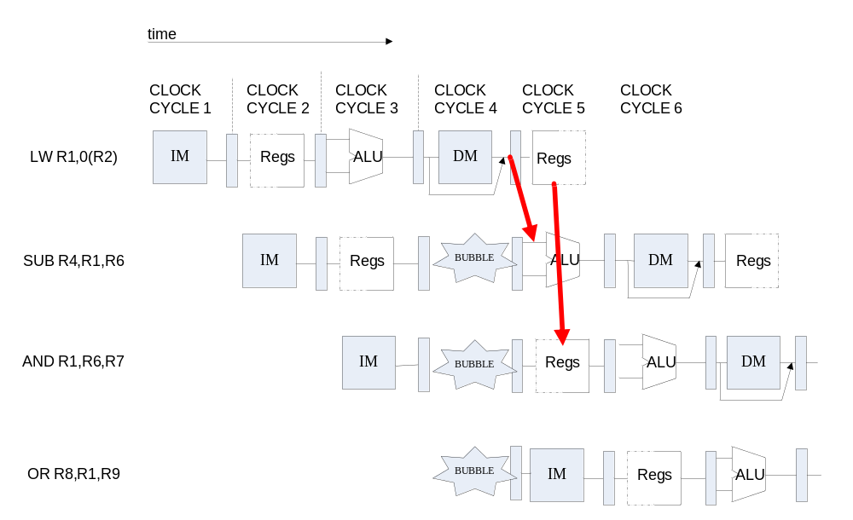
Pipeline Stalls

Slide 14
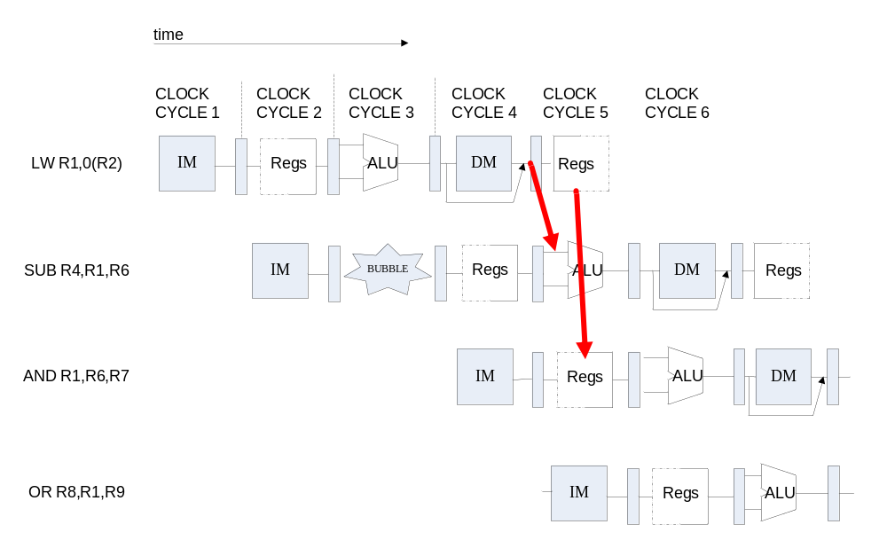
Pipeline stalls at ID Stage

Slide 15
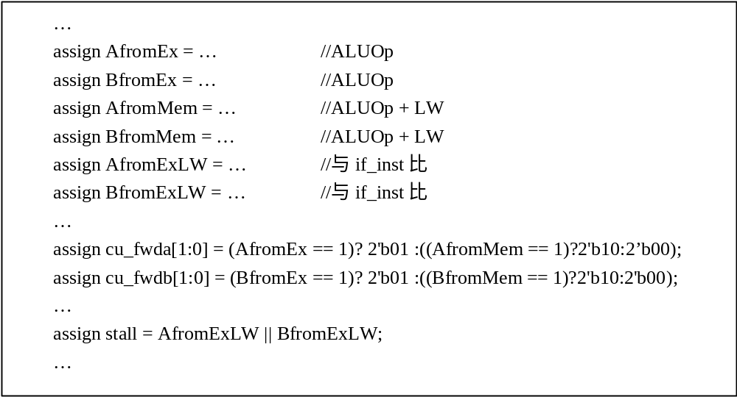
Condition in which Pipeline Forwards and stalls

Slide 16
Pipelined CPU Top Module
module top (input wire CCLK, BTN3, BTN2, input wire [3:0]SW, output wire LED, LCDE, LCDRS, LCDRW, output wire [3:0]LCDDAT);
assign pc [31:0] = if_npc[31:0];
if_stage x_if_stage(BTN3, rst, pc, mem_pc, mem_branch, id_wpcir, …
IF_ins_type, IF_ins_number,ID_ins_type,ID_ins_number);
id_stage x_id_stage(BTN3, rst, if_inst, if_pc4, wb_destR,…,
EX_ins_type, EX_ins_number, id_FWA, id_FWB);
ex_stage x_ex_stage(BTN3, id_imm, id_inA, id_inB, id_wreg, ..
id_FWA, id_FWB,mem_aluR, wb_dest, … , MEM_ins_number);
mem_stage x_mem_stage(BTN3, ex_destR, ex_inB, ex_aluR, …
mem_aluR, ... , WB_ins_type, WB_ins_number);
wb_stage x_wb_stage(BTN3, mem_destR, mem_aluR, …
wb_dest, …, OUT_ins_type, OUT_ins_number);

Slide 17
Observation Info
Input
  West Button: Step execute
  South Button: Reset
  4 Slide Button: Register Index
Output
  0-7 Character of First line: Instruction Code
  8 of First line : Space
  9-10 of First line : Clock Count
  11 of First line : Space
  12-15 of First line : Register Content
  Second line : “stage name”/number/type
  stage name: 1-”f”, 2-”d”, 3-”e”, 4-”m”, 5-”w”

Slide 18
Thanks!

